Slide 1
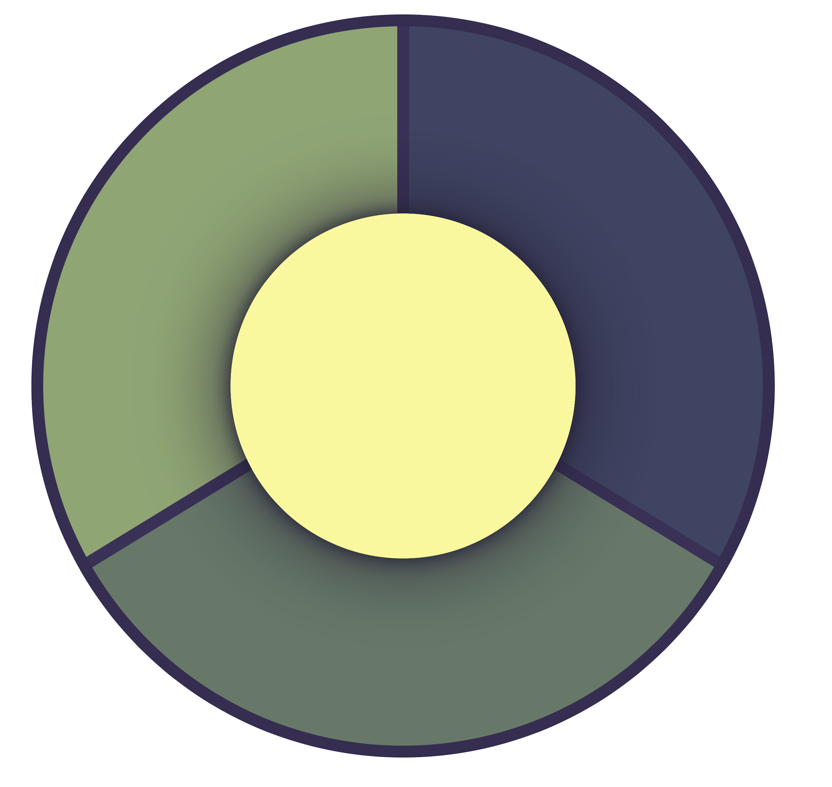
Habit
Frameworks
www.corporatecoach.training

Slide 2
Current Habit:
“I want to check in on my habit(s)”
What comes before this behavior?
What do I like about my current habit?
What little behaviors lead up to this behavior?
What do I get to do because of this habit?
What is the prompt?
What deeper craving does this satisfy?
What are the contributing factors in the context?
What emotions and thoughts do I have?
Cue/Trigger
Craving
Emotions
Thoughts
1
2
4
3
Reward
Routine/Response
What is my current reward?
What do I do to satisfy my craving?
How do I experience a celebration?
What are all the little behaviors that I do?
What thoughts/emotions do I experience afterwards?
What changes each time I do this?
What is different now that I am paying attention?
What doesn’t change about my response?
See:
Power of Habit - Charles Duhigg
Tiny Habits - BJ Fogg
Atomic Habits - James Clear
Corporate Sponsored Coaching
www.corporatecoach.training

Slide 3
Habit to
Change:
“I want to get rid of this bad habit.”
What comes before?
What positive thing could I do along with this habit?
How can I be more aware?
What do I get to do if I make this change?
How can I remove the prompt?
What are my emotions telling me about this challenge?
How can I change the context?
What am I excited about in making this change?
Cue/Trigger
Craving
Emotions
Thoughts
1
2
4
3
Reward
Routine/Response
What is the benefit I get to experience?
What will I do differently?
What immediate “pain” could I add?
What would make this easier?
How could I celebrate success?
What will be my reminder?
How can I practice this celebration?
How will I track my behavior?
See:
Power of Habit - Charles Duhigg
Tiny Habits - BJ Fogg
Atomic Habits - James Clear
Corporate Sponsored Coaching
www.corporatecoach.training

Slide 4
New Habit
Plan:
“I want to start a new, healthy habit”
What current habit can I use as a trigger?
What positive thing could I do along with this habit?
What do I want my new habit to come after?
What do I get to do if I make this change?
How can I add a prompt?
What are my emotions telling me about this challenge?
How can I improve the context?
What am I excited about in making this change?
Cue/Trigger
Craving
Emotions
Thoughts
1
2
4
3
Reward
Routine/Response
What is the benefit I get to experience?
What is a simple, easy beginning behavior?
What immediate “pleasure” could I add?
What would make this even easier?
How could I celebrate success?
What will be my reminder?
How can I practice this celebration?
How will I track my behavior?
See:
Power of Habit - Charles Duhigg
Tiny Habits - BJ Fogg
Atomic Habits - James Clear
Corporate Sponsored Coaching
www.corporatecoach.training

